Slide 1


I-BACUS-TECH
WEEKLY
REPORT
GOWTHAM P

Slide 2


X MIND
INSTALTION OF XMIND
USES
TYPE OF TEMPLATE
TYPE OF MIND MAP
HOW TO CHANGE STYLE

Slide 3
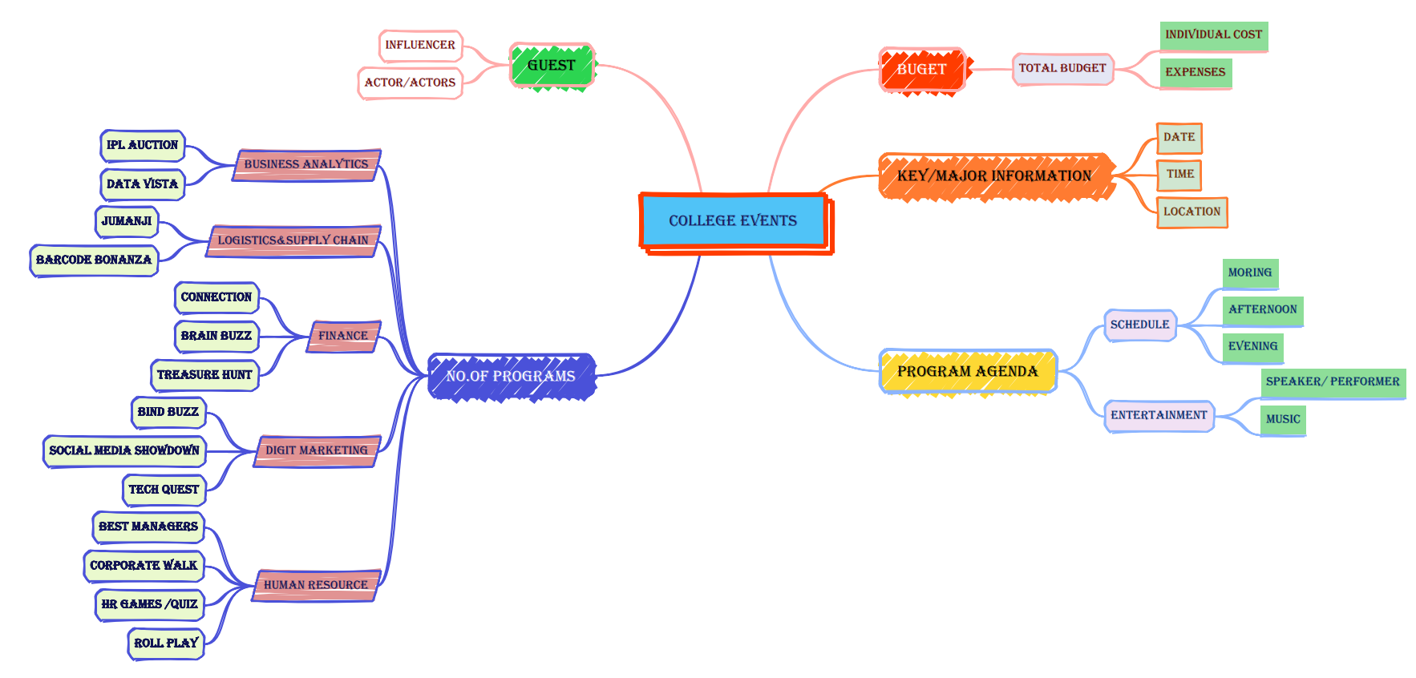

Slide 4


Design interactive reports with visuals like charts, tables, and maps
Power BI
DESKTOP
HOW TO GET DATA USING KAGGLE
TRANSFORM DATA
TEXT BOX
CARD
CHARTS
BOOKMARKS NAVIGATOR
SLICER
MAP
PARAMETER

Slide 5






THANK YOU !

